Slide 1

DriverPass System Analysis
Alex Hudson
Notes:
[No speaker notes required for this slide.]

Slide 2

System Requirements
Functional requirement: database must store user login information and payment info upon package purchase
Nonfunctional requirement: system must maintain 99.9% uptime
Functional requirement: Appointment system must show what dates and times are not available.
Nonfunctional requirement: System should include 2 factor authentication system.
Notes:
To start with the database requirement, the database will be the core of the data storage because a database will be able to sort itself automatically. Furthermore, the database can be used to create the reports needed for downloading to check progress or bring it to the DMV. AS for the 99.9% uptime nonfunctional requirement, this is the single most vital piece of any network or system because this ensures that your system is fully functional and always running. This should also be fixed as soon as possible if the system goes down unexpectedly. The appointment system is also of the most crucial parts of your system because when the students pay for their package of choice, they need to be able to use the time allowed for driving lessons. Having the system tell the student what days and time are taken allows for them to make appointment without any hassle. Two factor authorization is also one of the best ways to prevent any user from being hacked and an excellent way to verify the user’s identity.

Slide 3
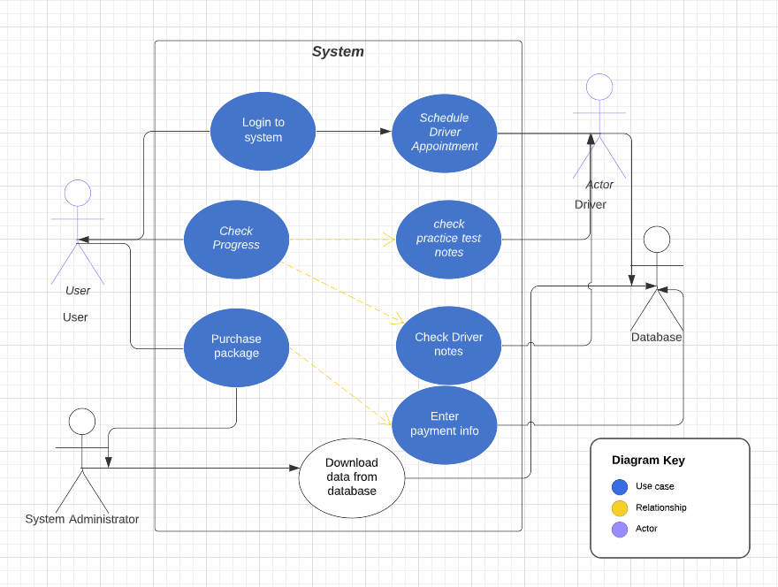
Use Case Diagram
Notes:
This diagram explains how the different users involved in the system communicate and how they will use this system. The groups involved in this system are the student, driver, the database, and the administrator. The use cases for this design are logging into the system, paying for the package, checking driver notes, test progress and overall driving progress, schedule an appointment, and downloading the reports created by the database, one of the needs of the client. The other needs that this design meets are the decision of the payment package system, the ability to download reports, as previously stated, the understanding of the appointment system and with a verified account online, and the collection of the student’s information for their profile.

Slide 4
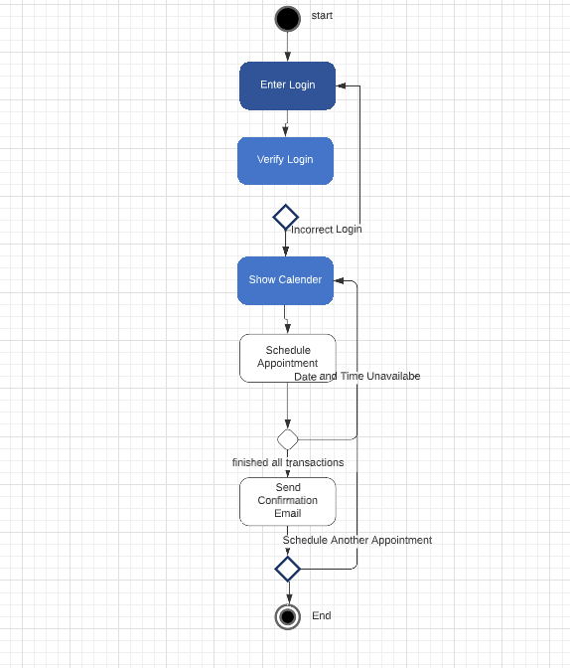
Activity Diagram
Notes:
This diagram explains the process to schedule an appointment. The steps in this design that I have created are as follows: the student enter their login info, the system and database verify and if it is incorrect, the student must reenter until it is correct. Then the main page appears before the student, at which the student will go to the appointments section to schedule the appointment. A calendar will appear and show the dates and times that are available and unavailable, labeled separately and in a distinguished way, for the student to decide his two-hour appointment with a driver. Should all go well, he will then be prompted if they would like schedule another and display how many sessions left, they have and if the student does not wish to schedule another appointment, process completes. This system meets the primary necessity of scheduling online for the student, as well as the needs of spreading out the lessons and sessions and keeping in contact with the driver to verify appointments and pick up locations.

Slide 5
Security
Include firewall for added security and file checking
Use 2-factor authentication system to verify user identity
Database must have separate login information for system admins
Anti malware system should be installed onto the server in case firewall lets malware through
Notes:
Overall, security is the most important basis of any system that works on the web and even the cloud. The biggest issue with this is this company is dealing with payment information from multiple students and without secure databasing and logins, consumer trust will exist. I put this security structure to keep in mind that this system will be handling personal identifiable information, or PII for short. This information includes but is not limited to credit or debit card information, billing and mailing addresses, a student’s and a driver’s full name, and the emails of the students and drivers hired by the company. Which also brings me to discuss the reasons for this structure. To start with the firewall, a firewall system will allow the system to be secured by checking all incoming connections for malware and hostile computer attacks like denial-of-service attacks. For reference, a denial-of-service attack is where a user sends an exceedingly high amount of unnecessary data through a network in an effort to shut down the system. Having the database use a separate login will allow the system administrators to have access to the database without reuse of their normal login information and this will also prevent any external attacks because the normal login info will not work on the database, preventing attackers from getting any PII. Adding anti malware systems will essentially aid the firewall by being a second line of defense for it and will prevent the system from having any problems related to computer attacks and malware.

Slide 6
System Limitations
System must have a server to run the cloud system off of for the website.
To maintain 99.9% uptime, regular server and website updates must occur.
Connection scalability for employees may require more switches for wired connections
Mobile friendly website more than likely required for this system. May take extra time to create this.
Notes:
These limitations were carefully understood when creating this design. To start with the cloud system limitation, all of the cloud systems used to date require some sort of server to run effectively and stay up to 99.9% uptime. This is the only way for a cloud system to work without renting a system from companies like Amazon, Cisco and NETGEAR. Turning to the uptime limitation, regular updates of the system, website and security will not only aid in the protection of the system, but will help keep the system running to its fullest potential without any issues. Onto the connection limitation, scalability is a very big key in any system that deals with the internet. Where yes, the majority of the staffing will be the drivers, the ability to have service representatives will be when the scaling of the system be needed to have some thought in. the drivers do only need to have a database entry for them, as they will not be in an office space of any kind. The final limitation discusses how the website should operate on a smart phone or tablet. These devices require a sort of different design structure and where it is very much possible, this will take some time after the website is completed to add into the system. The necessity of this will also be vital in the aid of the drivers to be able to add the pickup location of the student into a phone GPS system.

